Slide 1
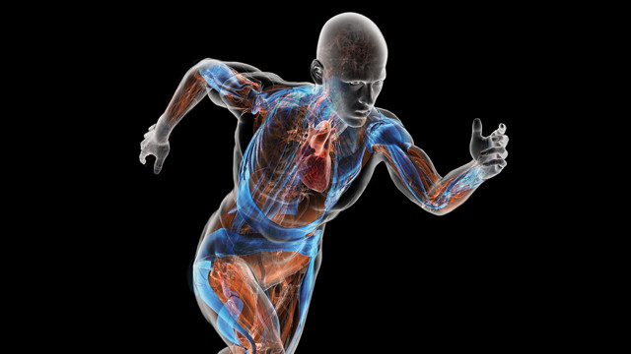
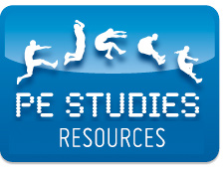
UNIT 1 & 2 − Functional Anatomy 2nd ed.
https://www.flickr.com/photos/bethscupham/7311996502

Slide 2
UNIT 1 & 2 − Functional Anatomy 2nd ed.
COPYRIGHT
© PE Studies Resources 2019.
All rights reserved.
No part of this publication may be reproduced, stored in a retrieval system or transmitted in any form by any means whatsoever without the prior permission of PE Studies Resources.
DISCLAIMER
This product has been developed to assist teachers in the delivery of the Unit 1 & 2 WACE Physical Education Studies course. It represents the authors’ interpretation and approach and is not endorsed by any governing body. Every effort has been made to ensure the accuracy of the information in this PowerPoint. PE Studies Resources cannot take responsibility for any claim, loss, damage or liability arising from the use of, or reliance on, the information contained in this resource.
©PE STUDIES RESOURCES

Slide 3
CONTENTS
Anatomical terminology Muscle action and joint movements Flexion and extension Abduction and adduction Rotation Circumduction Pronation and supination Dorsi flexion and plantar flexion
Skeletal system Structure Major bones Functions
Muscular system Major muscles Characteristics of skeletal muscle tissue Excitability Extensibility Contractibility Elasticity

Slide 4
CONTENTS
Musculoskeletal system Classification of joints Types of synovial joints Origin and insertion points of muscles Agonist and antagonist
Circulatory system Functions Structure Heart Blood vessels Blood
Respiratory system Functions Structure Lungs Diaphragm Alveoli Mechanics of breathing
References

Slide 5
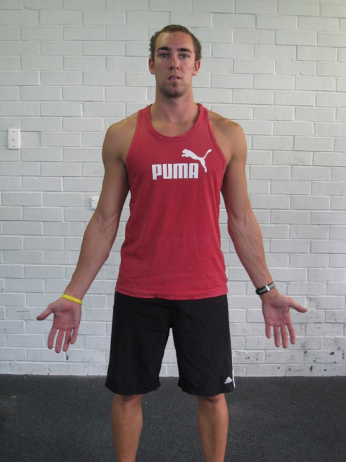
ANATOMICAL TERMINOLOGY
The anatomical position is the standard reference position used from which all other movements occur.
It is assumed to be standing, both feet together, arms by side, and the head and eyes and palms of the hands facing forwards.

Slide 6
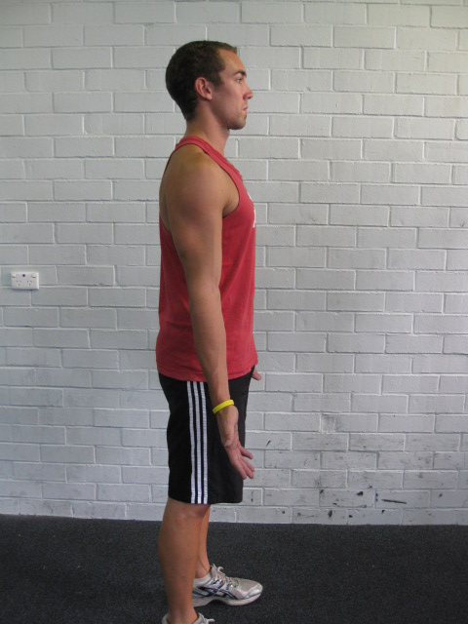
ANATOMICAL TERMINOLOGY
POSTERIOR
Behind the reference point of the structure
ANTERIOR
In front of the reference point of the structure
Please note:
The reference point is for relative purpose only. The terms anterior and posterior are in relation to a particular reference point on the body.

Slide 7
ANATOMICAL TERMINOLOGY
Please note:
The reference point is for relative purpose only. The terms superior and inferior are in relation to a particular reference point on the body.
SUPERIOR
Above the reference point of the structure
INFERIOR
Below the reference point of the structure

Slide 8
ANATOMICAL TERMINOLOGY
Midline
MEDIAL
Towards the midline of the structure
LATERAL
Away from the midline of the structure

Slide 9
ANATOMICAL TERMINOLOGY
PROXIMAL
Closer to the attachment point of a limb
e.g. proximal end of humerus
DISTAL
Further away from the attachment point of a limb
e.g. distal end of humerus

Slide 10
ANATOMICAL TERMINOLOGY
SUPERFICIAL
Towards the surface of a structure
DEEP
Further away from the surface of a structure

Slide 11
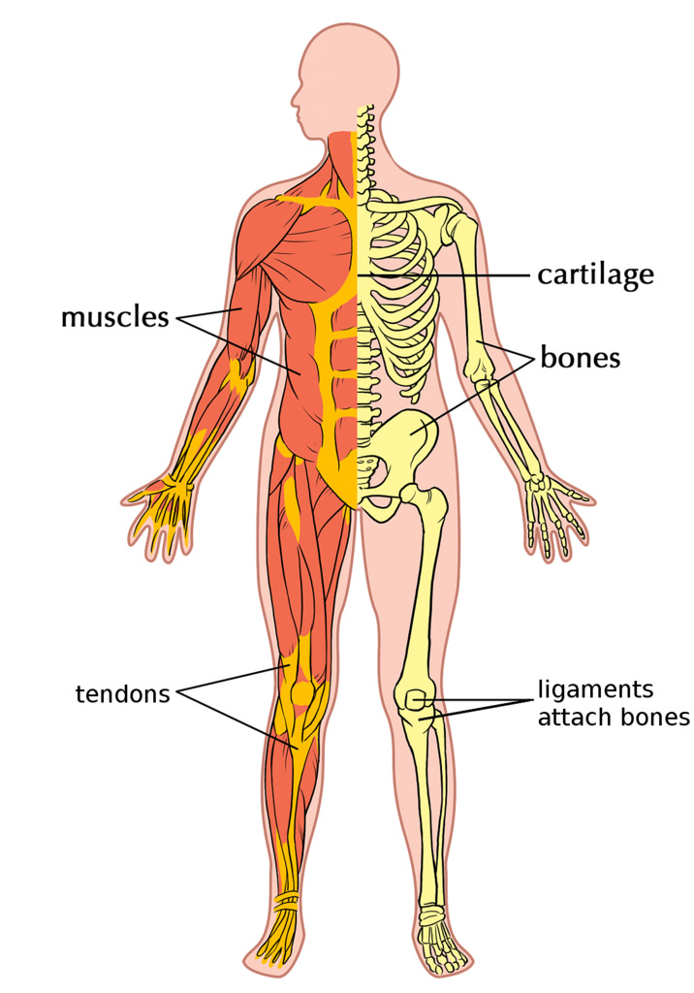
MUSCLE ACTION & JOINT MOVEMENT
Movement types created by muscle action and joint movement
flexion
circumduction
extension
supination
rotation
dorsi flexion
pronation
abduction
plantar flexion
adduction
School Curriculum and Standards Authority. Physical Education Studies ATAR Year 11 Syllabus, 2016.
11
Home
https://www.flickr.com/photos/121935927@N06/13578837903

Slide 12
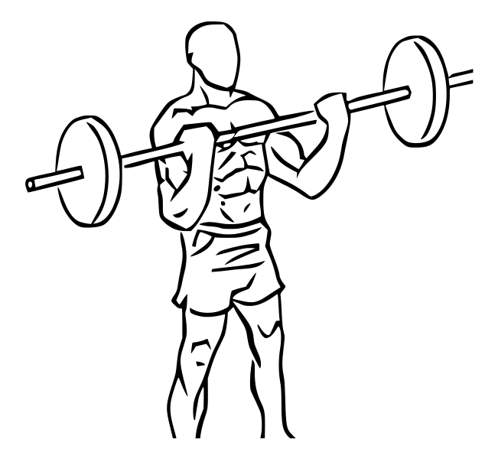
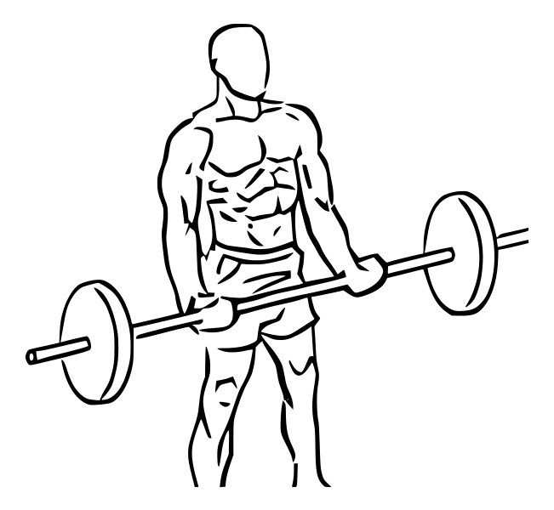
MUSCLE ACTION & JOINT MOVEMENT
Movement occurs when the tendons of the muscles which cross that joint exert a force on the bones resulting in movement taking place.
FLEXION
Results in joint angle decreasing
EXTENSION
Results in joint angle increasing
https://commons.wikimedia.org/wiki/File:Bicep_curls_with_barbell_2.svg
https://commons.wikimedia.org/wiki/File:Bicep_curls_with_barbell_1.svg
Home
12

Slide 13
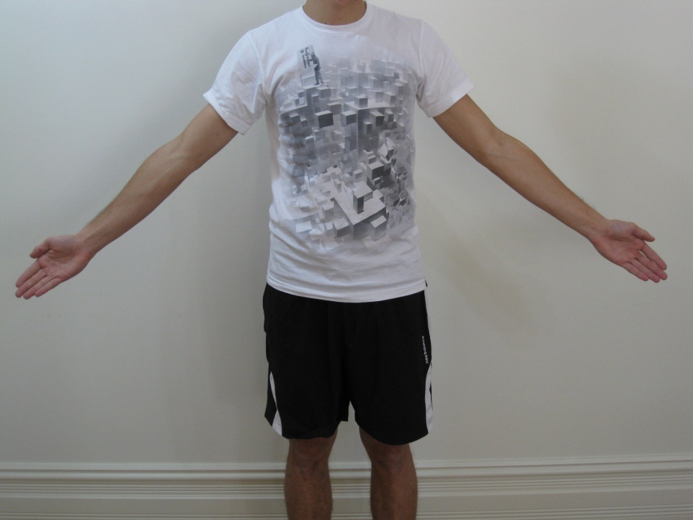
MUSCLE ACTION & JOINT MOVEMENT
ABDUCTION
Movement away from the midline of the body (arms and legs)
ADDUCTION
Movement towards the midline of the body (arms and legs)
13
Home

Slide 14
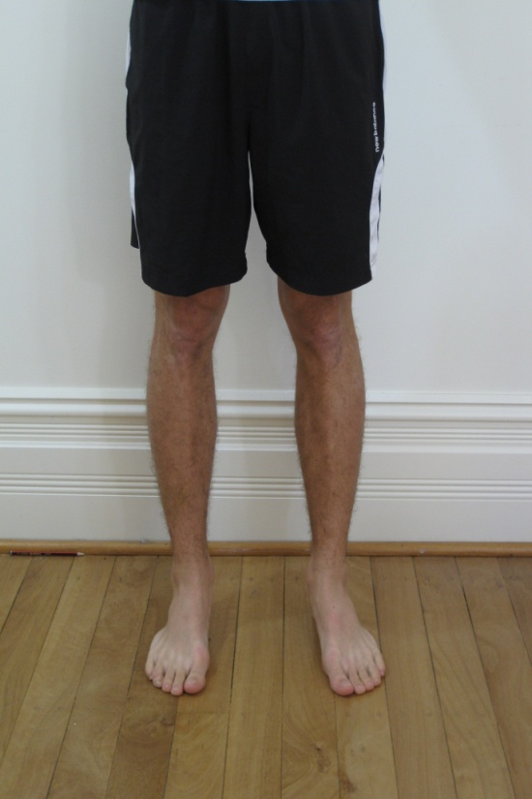
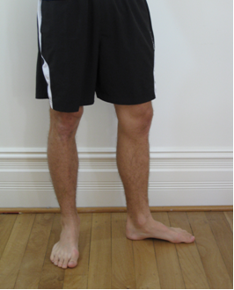
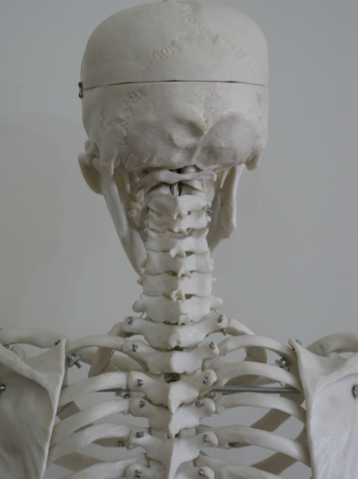
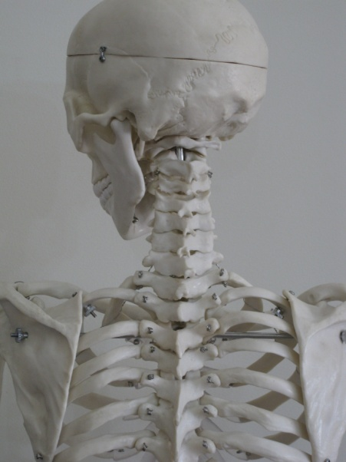
MUSCLE ACTION & JOINT MOVEMENT
ROTATION
A motion that occurs when a part turns on its axis.
E.g. The leg rotates on the hip, the head rotates on the neck.
Home
14

Slide 15
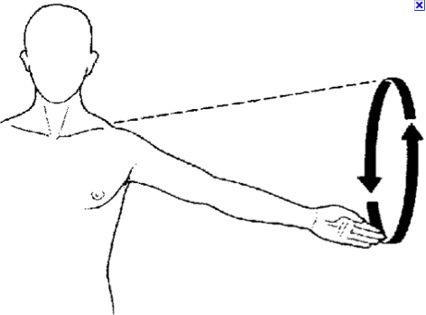
MUSCLE ACTION & JOINT MOVEMENT
CIRCUMDUCTION
The circular movement of a limb
Home
15

Slide 16
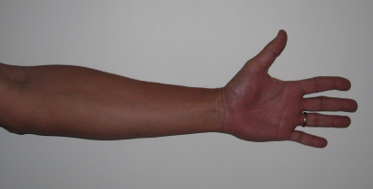
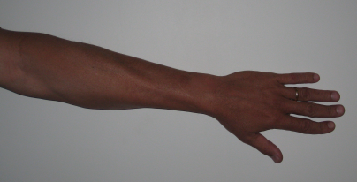
MUSCLE ACTION & JOINT MOVEMENT
PRONATION
In the forearm, refers to the
turning of the forearm and hand
so that the palm is facing down.
SUPINATION
In the forearm, refers to the
turning of the forearm and hand
so that the palm is facing up.
Home
16

Slide 17
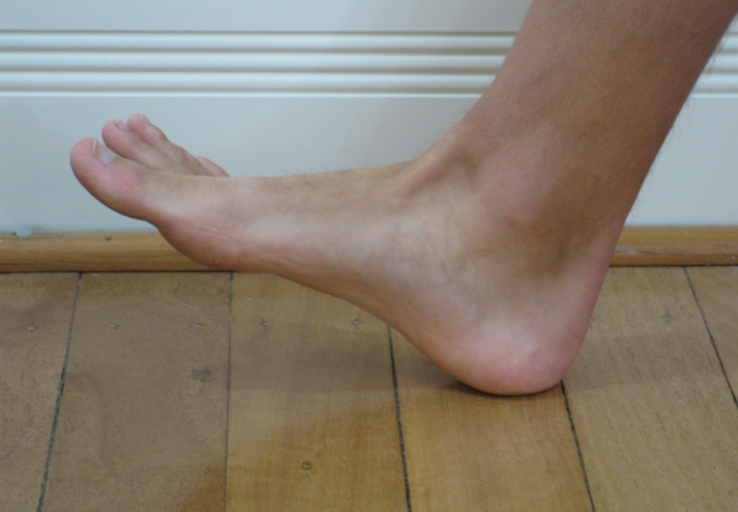
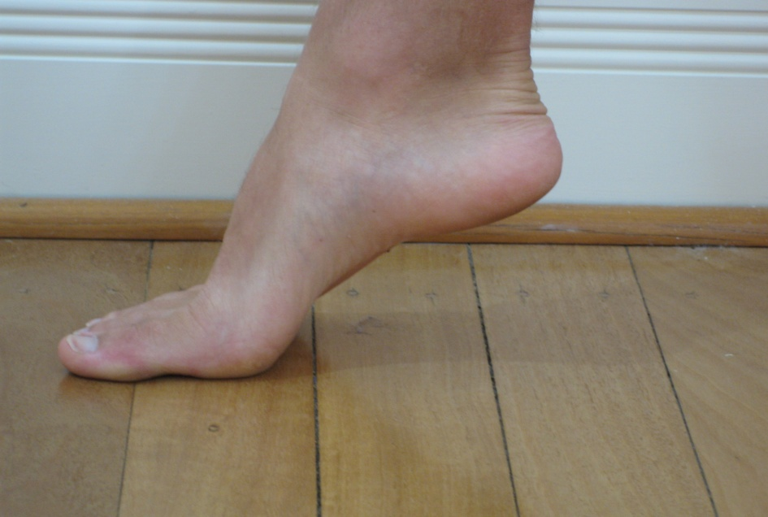
MUSCLE ACTION & JOINT MOVEMENT
DORSI FLEXION
Movement which decreases the angle between the foot and the leg, so that the toes are brought closer to the shin.
PLANTAR FLEXION
Movement which increases the angle between the foot and the leg, so that the toes are taken further away from the shin.
Home
17

Slide 18
STRUCTURE OF THE SKELETAL SYSTEM
The human skeleton is made up of over 200 bones, held together by tough bands of
connective tissue called ligaments.
An articulation occurs where two or more bones meet to form a joint.
The human skeleton can be divided into 2 main sections;
1. Axial skeleton
Forms the basic central structure to support the remainder of the skeleton
Also serves to protect many of the vital organs
Skull protects the brain
Vertebrae protects the spinal cord
Ribs protect the heart, lungs and kidneys
Appendicular skeleton
Major role is to assist with movement and includes the major limbs.
Arms
Legs
Shoulder and pelvic girdles
Home
18

Slide 19
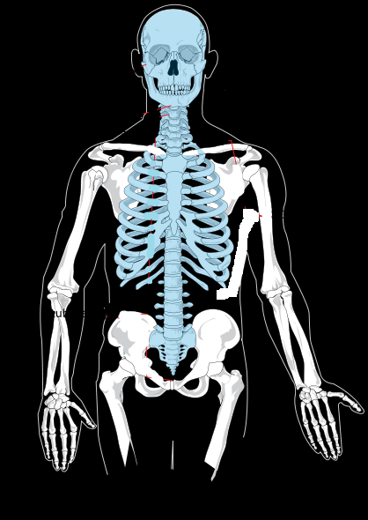
STRUCTURE OF THE SKELETAL SYSTEM
Axial skeleton
Skull
Vertebral column
7 cervical vertebrae (neck)
12 thoracic vertebrae (chest)
5 lumbar vertebrae (lower back)
5 sacral vertebrae (sacrum)
Coccyx
Thorax
12 pairs of ribs, 10 attaching to the sternum with the other two floating
Skull
Rib cage
Sternum
Ribs
Vertebral column
Axial skeleton forms the basic central structure to support the remainder of the skeleton.
http://commons.wikimedia.org/wiki/File:Axial_skeleton_diagram_lt.svg
19
Home

Slide 20
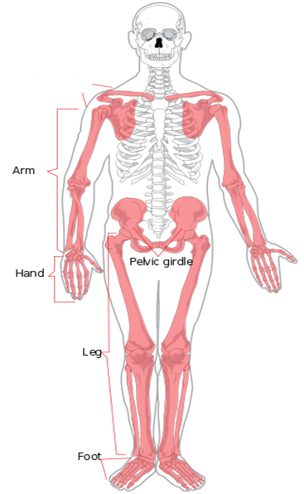
STRUCTURE OF THE SKELETAL SYSTEM
Appendicular skeleton
Shoulder girdle
Clavicle
Scapula
Arm
Humerus (upper arm)
Radius + ulna (forearm)
Wrist
Carpal bones
Hand
5 metacarpal bones
Phalanges (fingers)
Shoulder girdle
Appendicular skeleton assists with movement and includes all the major limbs
http://commons.wikimedia.org/wiki/File:Appendicular_skeleton_diagram.svg
20
Home

Slide 21
STRUCTURE OF THE SKELETAL SYSTEM
Appendicular skeleton (cont.)
Pelvic Girdle
2 hip bones
Sacrum + coccyx
Leg
Femur (upper leg)
Tibia + fibula (lower leg)
Ankle
7 tarsal bones
Foot
5 metatarsals
Phalanges
Shoulder girdle
Appendicular skeleton assists with movement and includes all the major limbs
http://commons.wikimedia.org/wiki/File:Appendicular_skeleton_diagram.svg
21
Home

Slide 22
STRUCTURE OF THE SKELETAL SYSTEM
Use of musculoskeletal structures in the production of movement
bones
humerus radius ulna femur patella | tibia fibula pelvis sternum ribs | carpals metacarpals phalanges tarsals metatarsals
School Curriculum and Standards Authority. Physical Education Studies ATAR Year 11 Syllabus, 2016.
©PE STUDIES RESOURCES
22
Home

Slide 23
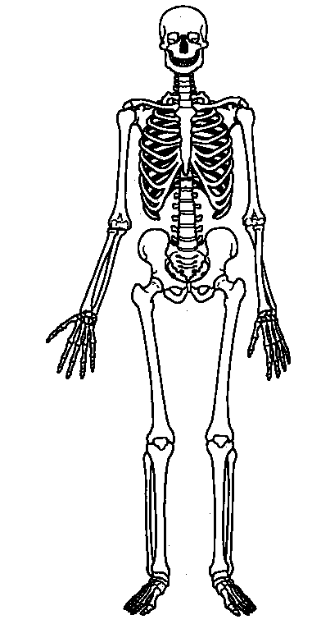
STRUCTURE OF THE SKELETAL SYSTEM
Practice
23
Home

Slide 24
STRUCTURE OF THE SKELETAL SYSTEM
Skull (Cranium)
Clavicle
Scapula
Humerus
Sternum
Ribs
Vertebral column
Radius
Ulna
Pelvis
Carpals
Metacarpals
Phalanges
Femur
Patella
Tibia
Fibula
Tarsals
Metatarsals
Phalanges
24
Home

Slide 25
SKELETAL SYSTEM
Functions of the skeleton
Provides framework for the body and gives it shape
Attachment points for muscles. When a muscle contracts, the bone it inserts into moves, acting as a lever to help create movement.
Protects vital organs e.g.;
Skull protects the brain
Ribs protect the heart, lungs and kidneys
Spinal column protects the spinal cord
Responsible for storing essential minerals such as calcium and phosphorous which contribute to the health and maintenance of bone tissue.
Produces red blood cells (RBC’s) in the bone marrow, particularly during high growth years such as childhood and adolescence.
Home

Slide 26
THE MAJOR MUSCLES OF THE HUMAN BODY
Use of musculoskeletal structures in the production of movement
muscles
biceps triceps gastrocnemius trapezius deltoid | quadriceps hamstrings tibialis anterior adductor group latissimus dorsi | soleus abdominal gluteus maximus Pectorals Hip Flexors
School Curriculum and Standards Authority. Physical Education Studies ATAR Year 11 Syllabus, 2016.
©PE STUDIES RESOURCES
26
Home

Slide 27
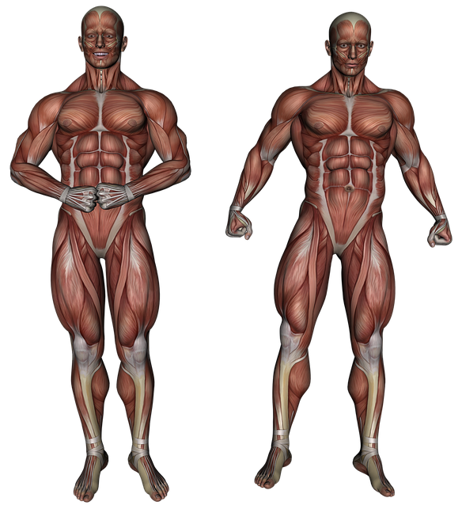
THE MAJOR MUSCLES OF THE HUMAN BODY
ANTERIOR (Front):
Deltoid
Biceps
Pectorals
Adductor group
Abdominals
Quadriceps
Tibialis Anterior
Hip Flexors
POSTERIOR (Back):
Deltoid
Trapezius
Triceps
Latissimus dorsi
Gluteus maximus
Hamstrings
Gastrocnemius
Soleus
THE MAJOR MUSCLES OF THE HUMAN BODY
https://pixabay.com/en/muscle-muscular-system-anatomy-3120521/
Home

Slide 28
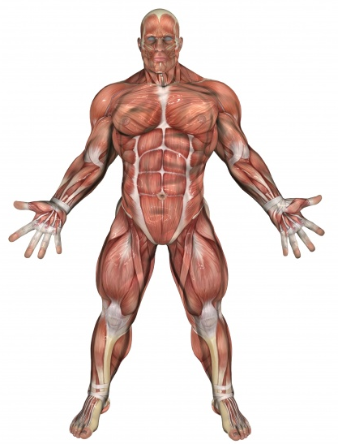
THE MAJOR MUSCLES OF THE HUMAN BODY
Major Muscles - Anterior
Practice
Home
https://www.publicdomainpictures.net/en/view-image.php?image=163621&picture=muscle-man-2
©PE STUDIES RESOURCES

Slide 29
THE MAJOR MUSCLES OF THE HUMAN BODY
Major Muscles - Anterior
Trapezius
Deltoid
Pectorals
Biceps
Abdominal
Adductor group
Hip Flexors
Tibialis anterior
Quadriceps
https://www.publicdomainpictures.net/en/view-image.php?image=163621&picture=muscle-man-2
Home

Slide 30
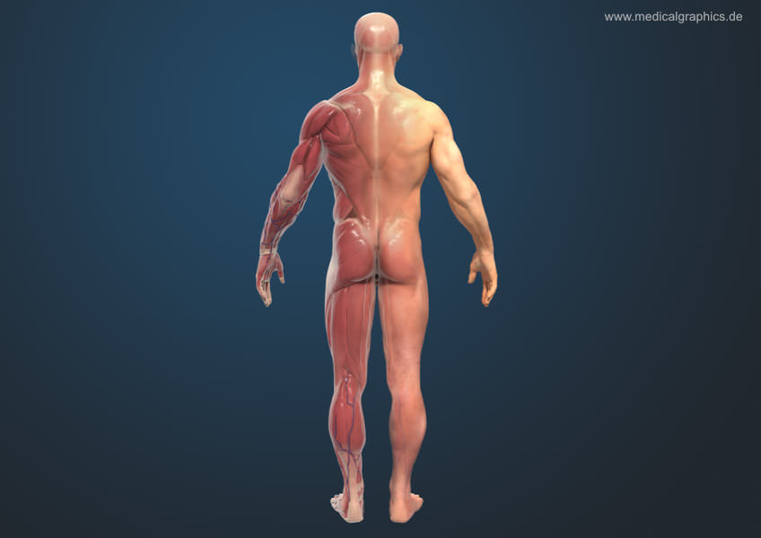
THE MAJOR MUSCLES OF THE HUMAN BODY
Major Muscles - Posterior
TEACHER RESOURCE
http://www.medicalgraphics.de/en/component/joomgallery/organs/muscles-man-back-dark.html
Home

Slide 31
THE MAJOR MUSCLES OF THE HUMAN BODY
Major Muscles - Posterior
Deltoid
Trapezius
Triceps
Latissimus dorsi
Gluteus maximus
Hamstrings
Gastrocnemius
Soleus
http://www.medicalgraphics.de/en/component/joomgallery/organs/muscles-man-back-dark.html
Home

Slide 32
Functions of the muscles
Functions of the muscles
Create movement. The muscular system’s main function is to allow movement. When muscles contract, they contribute to gross and fine movement.
Maintain posture. Skeletal muscles help keep the body in the correct position when someone is sitting or standing.
Maintain bodily functions:
Blood circulation
Digestion
Breathing
Generating heat. Maintaining normal body temperature is an important function of the muscular system. Almost 85 percent of the heat a person generates in their body comes from contracting muscles.
Home

Slide 33
Tendons and Ligaments
Tendons vs Ligaments
Tendons
A fibrous connective tissue which attaches muscle to bone, such as the Achilles tendon.
Tendons may also attach muscles to structures such as the eyeball.
Serves to move the bone.
Ligaments
A fibrous connective tissue which attaches bone to bone, such as the ACL.
Serves to hold structures together and keep them stable.
Home

Slide 34
CHARACTERISTICS OF SKELETAL MUSCLE TISSUE
Characteristics of skeletal muscle tissue and their relationship to the production of movement for physical activity
excitability
contractibility
extendibility
elasticity
School Curriculum and Standards Authority. Physical Education Studies ATAR Year 11 Syllabus, 2016.
©PE STUDIES RESOURCES
34
Home

Slide 35
CHARACTERISTICS OF SKELETAL MUSCLE TISSUE
Excitability
The ability to contract in response to chemical and/or electrical signals.
For a muscle to contract, its cells must be stimulated, typically via nerve impulses as messages are sent from the Central Nervous System.
Nerve impulses cause the release of acetylcholine which activates receptors on the surface of the muscle cell.
This results in the release of sodium ions into the muscle cell and a depolarization of the muscle cell membrane.
If the membrane becomes sufficiently depolarized, an action potential results and the muscle cell is then "excited"

Slide 36
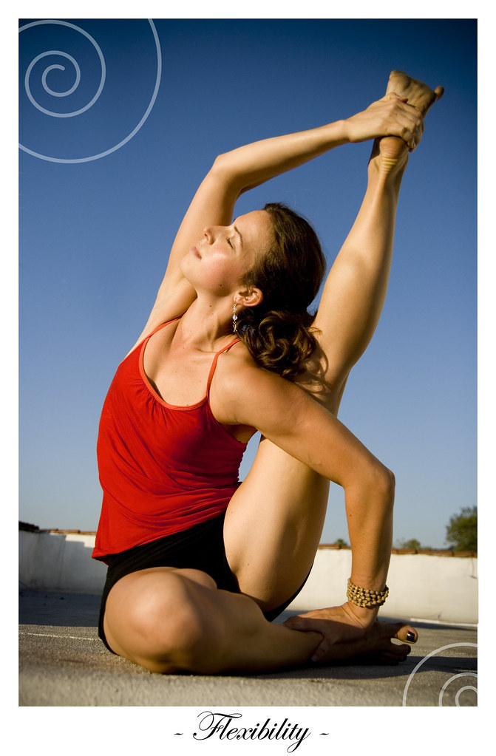
CHARACTERISTICS OF SKELETAL MUSCLE TISSUE
Extensibility
The capacity of a muscle to stretch beyond its normal resting length.
Can stretch to 1½ times its resting length
This is important because in the coordination of movements, muscles operate in pairs such that one is lengthening while the other is contracting.
Flexibility is highly specific to muscle groups and can be improved through regular training.
Loss of extensibility will also occur rapidly in the absence of training
©PE STUDIES RESOURCES
https://www.flickr.com/photos/16462767@N00/3983734887

Slide 37
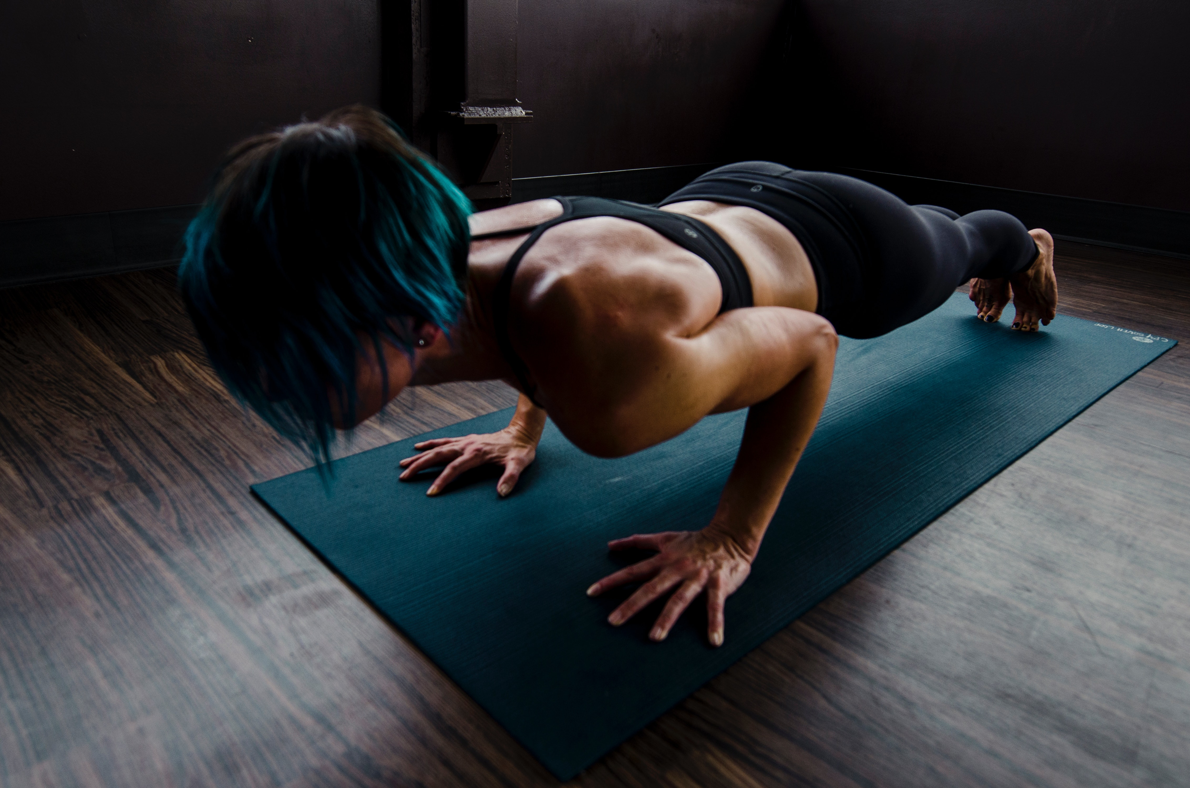
CHARACTERISTICS OF SKELETAL MUSCLE TISSUE
Contractibility
The ability of a muscle to contract or shorten.
The ‘all-or-none principle’ states that all the muscle fibres in a motor unit will either contract with 100% force or not at all.
This is determined by whether or not the signal transmitted from the brain is above or below the threshold required for contraction
To increases the strength of contraction, the brain simply sends more signals or stronger signals, resulting in the recruitment of more motor units.
https://www.pexels.com/photo/woman-doing-push-ups-2780762/
©PE STUDIES RESOURCES

Slide 38
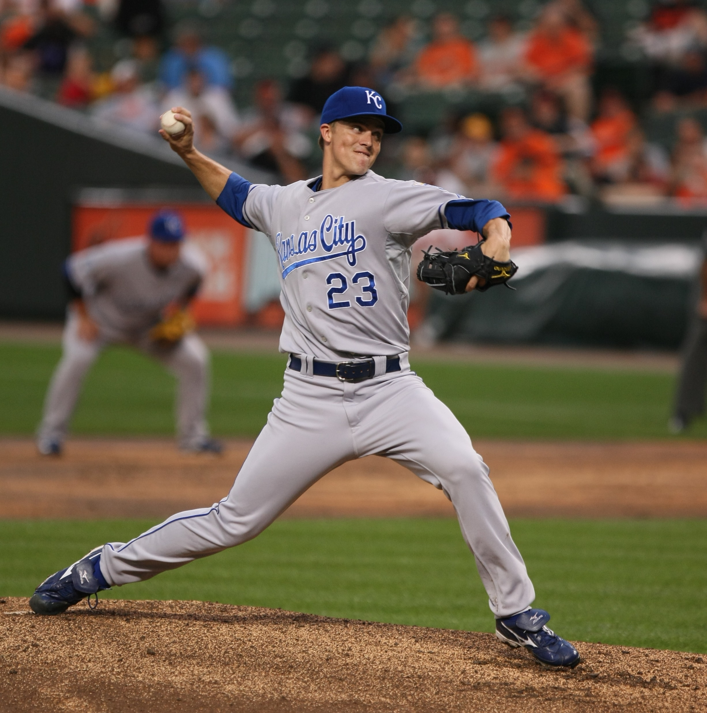
CHARACTERISTICS OF SKELETAL MUSCLE TISSUE
Elasticity
The ability of a muscle to return to the original resting length after it has been stretched.
During the throwing action, muscles of the chest and arm are stretched beyond resting length during the preparation phase, but then return to their resting length after the throw has been completed.
©PE STUDIES RESOURCES

Slide 39
HOW DOES THE MUSCULOSKELETAL SYSTEM PRODUCE MOVEMENT?
Relationship between the musculoskeletal system and joint movement in the creation of movement
antagonist pairs
origin and insertion points of muscles
School Curriculum and Standards Authority. Physical Education Studies ATAR Year 11 Syllabus, 2016.
©PE STUDIES RESOURCES
39
Home

Slide 40
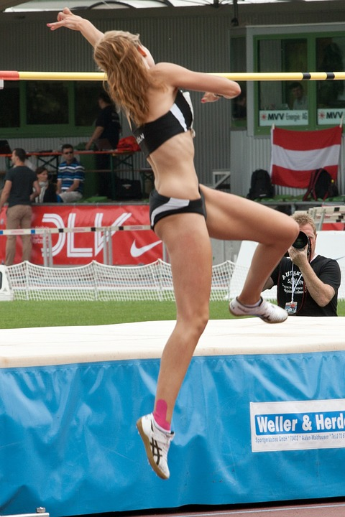
HOW DOES THE MUSCULOSKELETAL SYSTEM PRODUCE MOVEMENT?
The human body is made up of over 600 muscles, working together to provide both conscious and subconscious movements for the human body.
One of the major functions of the muscular system is to produce movement
PRODUCING MOVEMENT
Skeletal muscles which are consciously controlled (voluntary – “think then do”) are attached to 2 different bones across a joint
To create movement e.g. walking, swimming, the CNS delivers a message from the brain to the relevant muscle to contract, resulting in a pulling force to be exerted on the bone which causes movement to occur.
This enables the human body to perform day to day tasks and to respond quickly to changes in the external environment e.g. changing direction in a game of sport
https://pixabay.com/en/sport-athletics-high-jump-659563/
Home

Slide 41
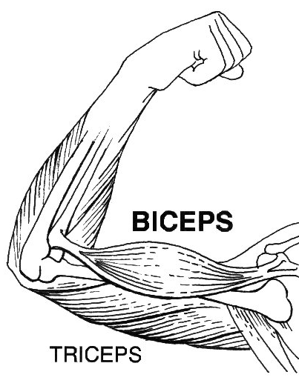
HOW DOES THE MUSCULOSKELETAL SYSTEM PRODUCE MOVEMENT?
Muscles have two attachment points onto the skeleton. Each attachment is on a different bone and across a joint.
The origin of a muscle is the attachment onto the bone that does not move when the muscle contracts.
The origin of a muscle is the attachment point at the proximal end (closer to midline of the body).
The insertion is attached to the bone which moves more when the muscle contracts.
Insertion of a muscle is the attachment point at the distal end (further from midline of the body
Origin
Insertion of Biceps
Origin of Biceps
Insertion
Insertion of Triceps
Origin of Triceps
https://commons.wikimedia.org/wiki/File:Biceps_(PSF).png
Home

Slide 42
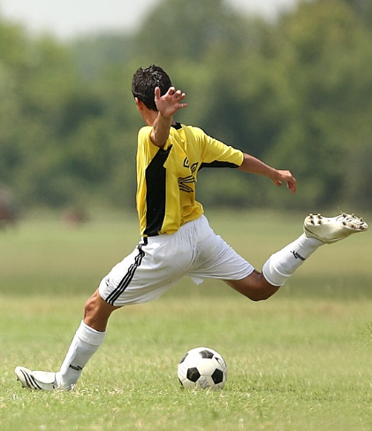
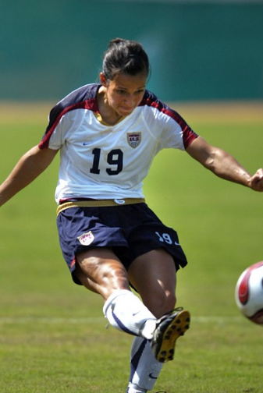
HOW DOES THE MUSCULOSKELETAL SYSTEM PRODUCE MOVEMENT?
How do muscles help us to move?
When a muscle contracts, it pulls on 1 of the 2 bones to which it is attached, creating movement.
All muscles work across a joint and when contraction occurs, movement takes place altering the joint angle.
Once a muscle contracts to move a bone, another muscle must contract to return the bone to its original position – muscles work in pairs to produce movement.
1
2
Picture 1
Player brings back his kicking leg
by contracting his hamstrings and relaxing his quadriceps
Picture 2
Player extends her kicking leg by contracting her quadriceps and relaxing her hamstrings.
In both instances movement occurs around the knee and hip joints which change angle.
https://pixabay.com/en/photos/soccer/
https://pixabay.com/en/photos/practice/?cat=sports
Home

Slide 43
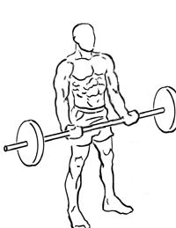
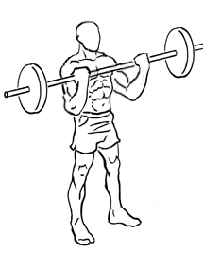
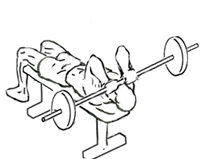
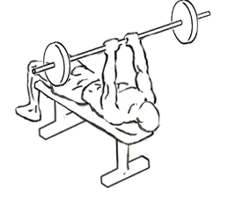
HOW DOES THE MUSCULOSKELETAL SYSTEM PRODUCE MOVEMENT?
The AGONIST (prime mover) is the muscle responsible for the movement.
The muscle which relaxes to allow the movement to occur is called the ANTAGONIST
The term reciprocal inhibition is used to describe the coordinated relaxing of muscles on one side of a joint to accommodate contraction on the other side of that joint.
https://commons.wikimedia.org/wiki/File:Lying-triceps-press-1.gif
https://commons.wikimedia.org/wiki/File:Jm-press-2.gif
https://commons.wikimedia.org/wiki/File:Bicep-curls-1.png
https://commons.wikimedia.org/wiki/File:Bicep-curls-2.png
Bicep Curl
Biceps - agonist - contract
Triceps - antagonist - relax
Triceps Extension
Triceps – agonist – contract
Biceps – antagonist - relax
Home

Slide 44
HOW DOES THE MUSCULOSKELETAL SYSTEM PRODUCE MOVEMENT?
FIXATOR muscles (or STABILISERS) are also involved in contractions by holding or stabilising a body part, making it immobile while another body part is moving.
Provides stability to the origin (most proximal end of the joint), so that maximal contraction force can be applied (called proximal stabilisation) & is usually an isometric contraction.
SYNERGIST muscles assist movement by stabilising and controlling the surrounding muscles to assist the production of smooth, controlled movement.
Bicep Curl – upwards phase
Trapezius = stabiliser
Biceps = agonist (contracts)
Trapezius contracts to stabilize the scapula, locking it in place and provides a strong, rigid base for the biceps to pull on in order to raise the bar.
https://commons.wikimedia.org/wiki/File:Bicep-curls-2.png
Home

Slide 45
HOW DOES THE MUSCULOSKELETAL SYSTEM PRODUCE MOVEMENT?
Muscle | Origin | Insertion
Biceps | Scapula | Ulna Radius
Triceps | Scapula Humerus | Ulna
Gastrocnemius | Femur | Tarsal
Trapezius | Skull Vertebrae | Scapula Clavicle
Deltoid | Clavicle Scapula | Humerus
Quadriceps | Femur Pelvis | Tibia
Hamstrings | Femur Pelvis | Tibia
Home

Slide 46
HOW DOES THE MUSCULOSKELETAL SYSTEM PRODUCE MOVEMENT?
Muscle | Origin | Insertion
Tibialis Anterior | Tibia | Metatarsal
Adductor Group | Pelvis | Femur
Latissimus Dorsi | Vertebrae Pelvis | Humerus
Soleus | Fibula Tibia | Tarsal
Abdominal | Pelvis | Ribs
Gluteus Maximus | Pelvis | Femur
Pectorals | Clavicle Sternum Ribs | Humerus
Home

Slide 47
REVISION QUESTIONS
z
1 The function of the skeletal system is to:
A/ provide protection of vital organs.
B/ allow movement.
C/ blood cell production
D/ all of the above
2. Which of the following form the axial skeleton ?
A/ skull, sternum, rib cage, vertebral column
B/ skull, shoulder girdle, spine, pelvic girdle
C/ skull, sternum, humerus, pelvis, femur
D/ shoulder girdle, arms, pelvic girdle, legs
3. Bones are attached to each other mainly by means of:
A/ ligaments
B/ muscle
C/ tendons
D/ skin
Home

Slide 48
REVISION QUESTIONS
z
8. Whilst carrying a tray in front of the body with the hands lying flat under the tray:
A/ the hands are flexed.
B/ the hands are extended.
C/ the hands are supinated.
D/ the hands are pronated.
9. The movement “adduction” involves :
A/ a decrease in the joint angle
B/ an increase in the joint angle
C/ taking a body part away from the midline of the body
D/ taking a body part towards the midline of the body
10. The muscles mainly responsible for making movements are known as:
A/ stabilisers.
B/ antagonists.
C/ agonists.
D/ fixators.
11. The muscle responsible for shrugging the shoulders is the:
A/ trapezius.
B/ rhomboids.
C/ latissimus dorsi.
D/ pectoralis major.
Home

Slide 49
REVISION QUESTIONS
z
12. Which pair of muscles does not have an agonist - antagonist relationship ?
A/ trapezius - rhomboids
B/ biceps - triceps
C/ quadriceps - hamstrings
D/ erector spinae - abdominals
13. When a muscle contracts it becomes:
A/ shorter.
B/ longer.
C/ it can be either of the above.
D/ it can be neither of the above.
14. In the action of throwing a ball which muscle is contracted ?
A/ the triceps - concentrically
B/ the triceps - eccentrically
C/ the biceps - concentrically
D/ the biceps - eccentrically
15. In the action of squatting down which muscle group is contracted ?
A/ the quadriceps - concentrically
B/ the quadriceps - eccentrically
C/ the hamstrings - concentrically
D/ the hamstrings - eccentrically
Home

Slide 50
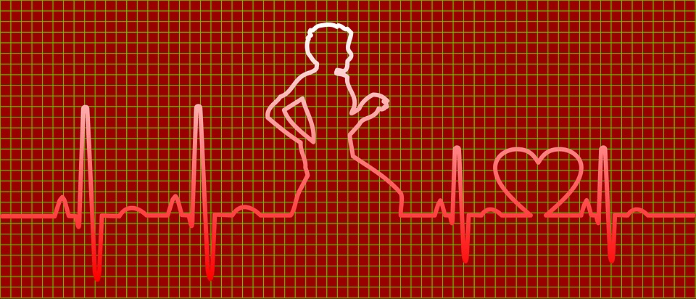
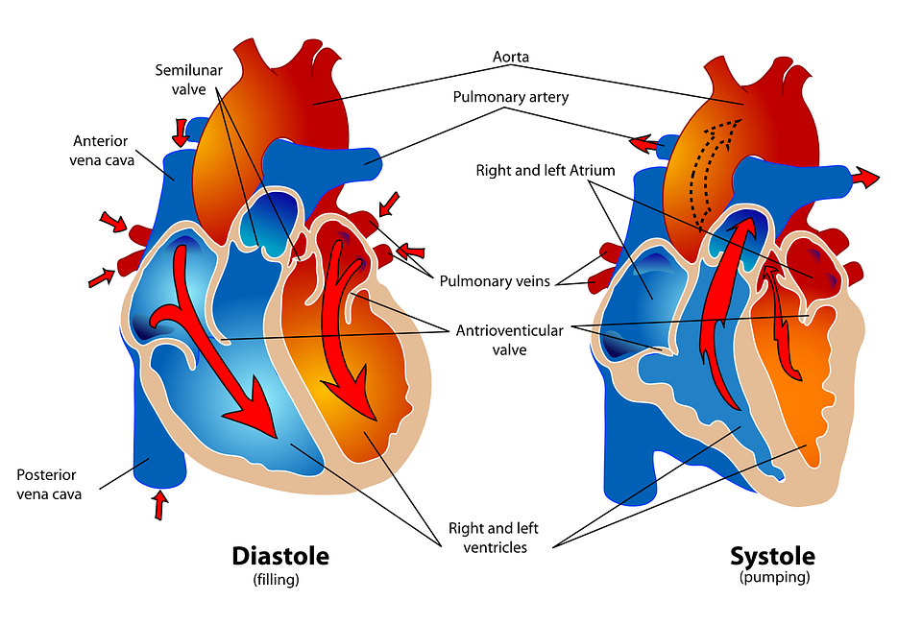
Structure and function of The CIRCULATORY system
Structure and function of the circulatory system
heart
arteries
veins
capillaries
blood
School Curriculum and Standards Authority. Physical Education Studies ATAR Year 11 Syllabus, 2016.
https://pixabay.com/en/photos/heartbeat/?image_type=illustration
https://pixabay.com/en/human-heart-pumping-care-medicine-41546/
©PE STUDIES RESOURCES
50
Home

Slide 51
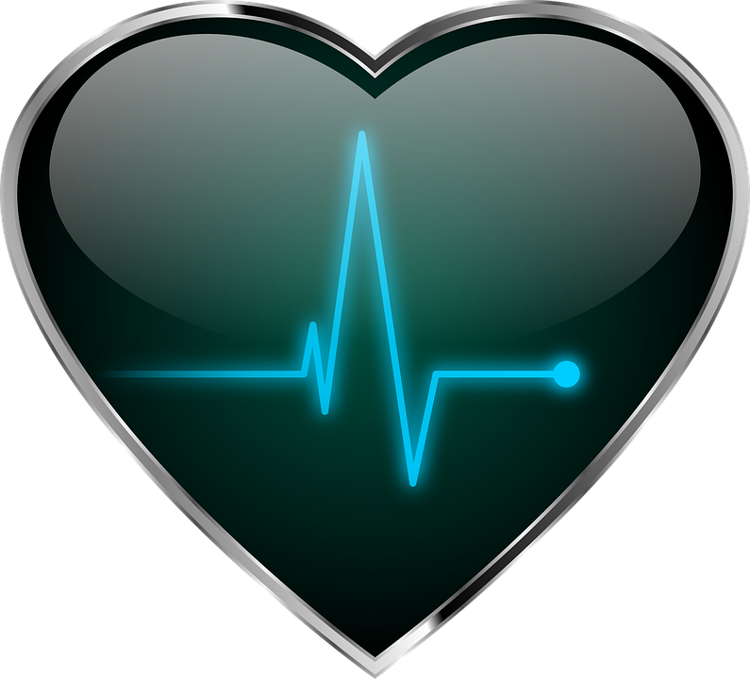
Structure and function of The CIRCULATORY system
The circulatory system (also known more commonly as the Cardiovascular System) consists of several structures that work together to transport oxygen and nutrients around the body
It consists of a network of arteries, veins, and capillaries, with the heart pumping blood through it.
Its primary role is to provide essential nutrients, minerals, and hormones to various parts of the body.
It’s also responsible for collecting metabolic waste from the cells and tissues to be expelled from the body.
51
Home
https://pixabay.com/images/search/heartbeat/

Slide 52
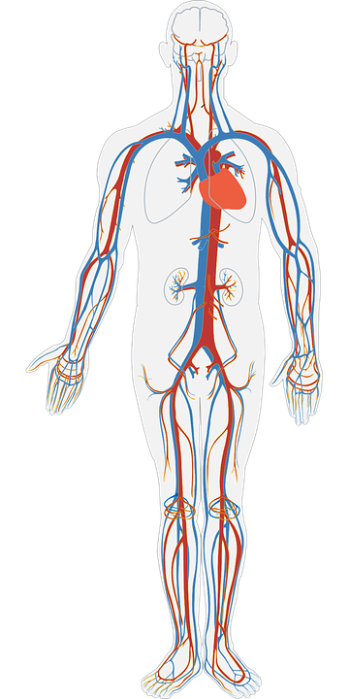
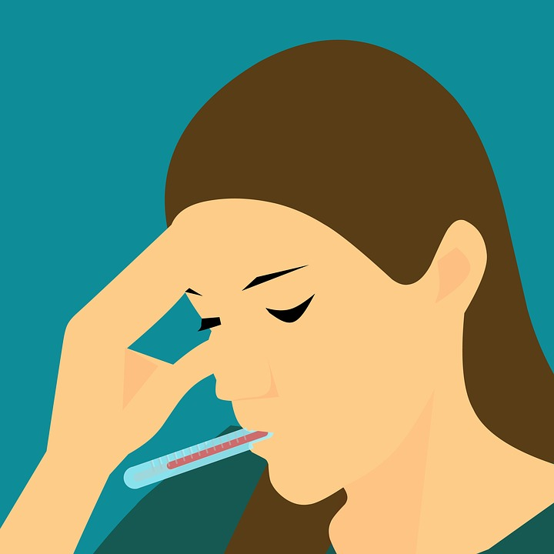
Structure and function of The CIRCULATORY system
Functions of the Circulatory System
Circulate blood to body
Transport O₂, water and nutrients to cells in the blood
Transport CO₂ and wastes away from the cells
Maintain body temperature
White blood cells fight infection
CIRCULATORY =
heart + blood vessels + blood
https://pixabay.com/en/fever-sick-cold-flu-thermometer-3590869/
52
Home
https://pixabay.com/en/human-body-circulatory-system-311864/

Slide 53
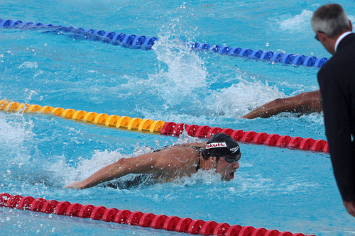
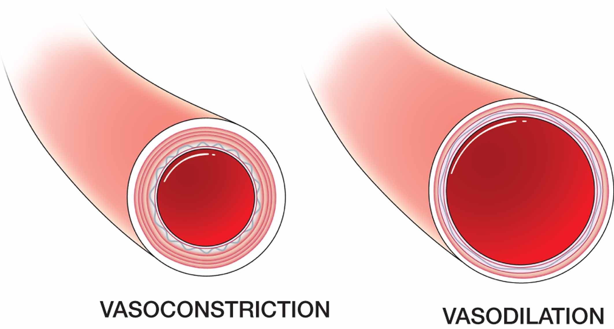
Structure and function of The CIRCULATORY system
Functions of the Circulatory System
During exercise, blood flow redistributes to the working muscles so that 80-90% of total Cardiac Output is directed to the working muscles.
Arteries open up (vasodilate) and constrict (vasoconstrict) to allow more or less blood to reach certain areas of the body.
Arteries taking blood to working muscles will open up (vasodilate) to allow more blood flow to the muscle whilst arteries taking blood to non active areas of the body contract (vasoconstrict) to reduce blood flow. This increases the amount of blood available to the working muscles.
1-3. Circulation of blood to the body
During rest approx. 20% cardiac output is directed to the muscles
During maximal exercise, approx. 80-90% cardiac output is directed to the muscles
www.flickr.com/photos/thewolf/3817797434/
https://biology-forums.com/gallery/13_01_09_13_1_50_41_132631007.jpeg
53
Home

Slide 55
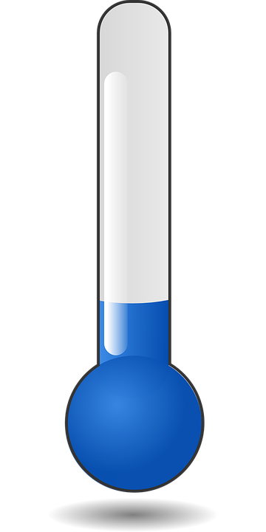
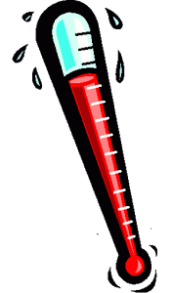
Structure and function of The CIRCULATORY system
Functions of the Circulatory System
4. Maintain body temperature
HYPOTHERMIA
Blood vessels will vasoconstrict (contract and reduce in diameter) to decrease the flow of blood to the skin thereby decreasing heat loss.
The body also responds by initiating small, involuntary body muscular contractions - ‘shivering’ - to increase body temperature.
Hypothermia is a potentially dangerous drop in temperature below 35ºC usually caused by prolonged exposure to cold temperatures
Hyperthermia is elevated body temperature above 38ºC due to failed thermoregulation that occurs when the body produces or absorbs more heat than it dissipates.
HYPERTHERMIA
The skin blood vessels will vasodilate (increase diameter) so there is more blood flow to the skin.
The body also responds by increasing sweat production to cool the body down via the evaporation of sweat on the skin surface.
55
Home

Slide 56
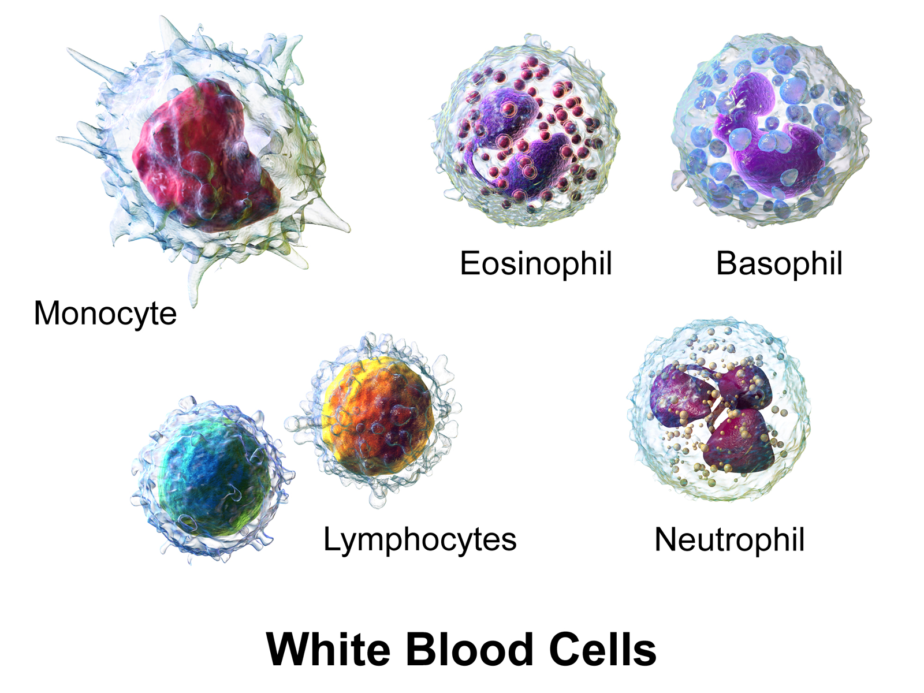
Structure and function of The CIRCULATORY system
Functions of the Circulatory System
Responsible for moving to sites of infection where they destroy bacteria and other disease causing organisms
5. White blood cells fight infection
https://commons.wikimedia.org/wiki/File:Blausen_0909_WhiteBloodCells.png
56
Home
©PE STUDIES RESOURCES

Slide 57
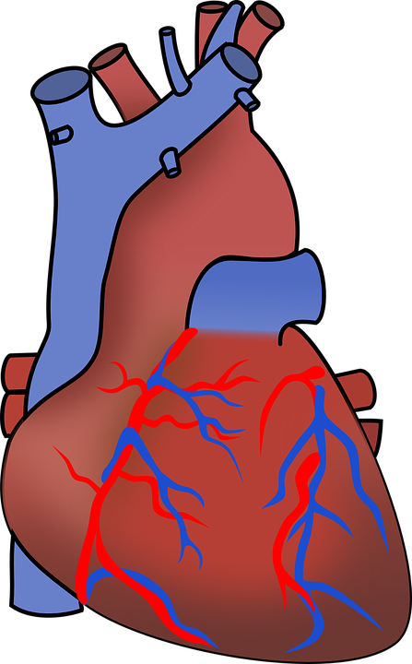
Structure and function of The CIRCULATORY system
Structure of the Circulatory System
Muscular pump which contracts continuously to drive blood around the body through the blood vessels
About the size of your fist, pear shaped
Protected by the ribs, sternum and vertebral column
Heart is separated into 2 sides, consisting of 4 chambers
Left atrium (receives oxygenated blood)
Right atrium (receives deoxygenated blood)
Left ventricle (pumps oxygenated blood)
Right ventricle (pumps deoxygenated blood)
1. Heart
https://pixabay.com/en/aorta-artery-blood-cardiac-151145/
57
Home

Slide 58
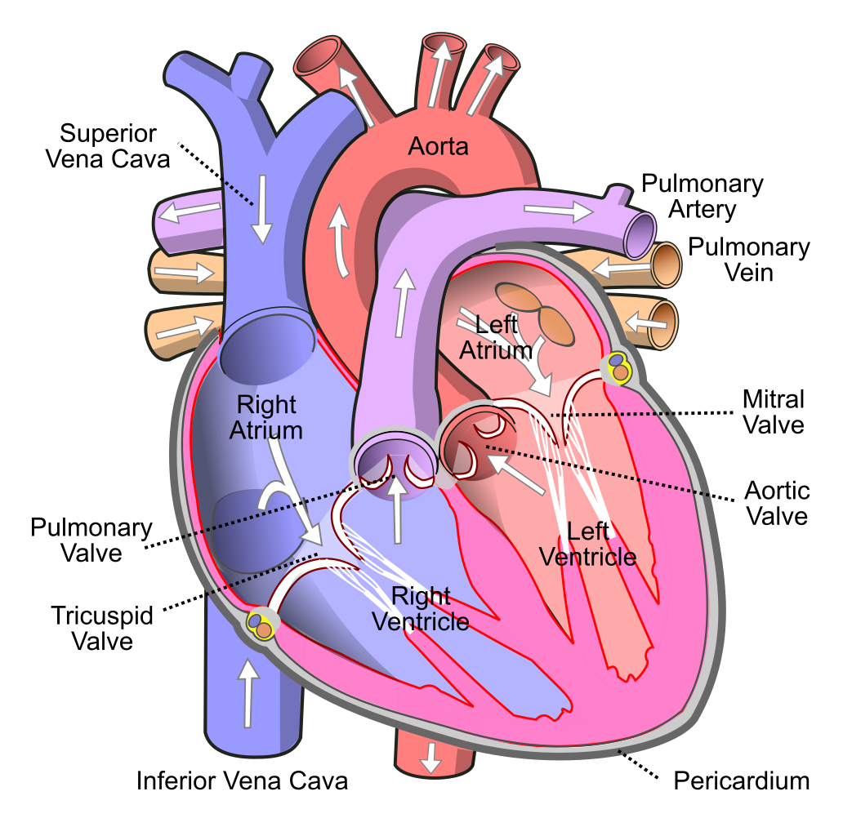
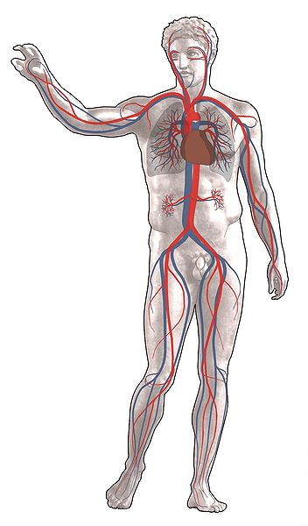
Structure and function of The CIRCULATORY system
https://en.wikipedia.org/wiki/File:Diagram_of_the_human_heart_(cropped).svg
http://commons.wikimedia.org/wiki/File:Grafik_blutkreislauf.jpg
58
Home

Slide 59
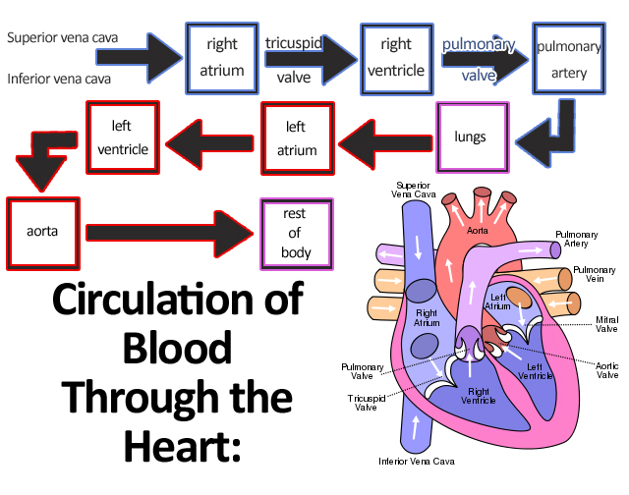
Structure and function of The CIRCULATORY system
The Right Atrium receives deoxygenated blood from the body (via the Vena Cavae) and pumps it to the lungs via the Right Ventricle (through the Pulmonary Artery) where it offloads the carbon dioxide and takes in oxygen.
This oxygenated blood then returns to the Left Atrium (via the Pulmonary Vein) and is pumped to the rest of the body by the Left Ventricle (via the Aorta)
Valves are located between the atrium and ventricles which ensure blood flows in only one direction – from the atrium to the ventricles.
https://commons.wikimedia.org/wiki/File:Circulation_of_Blood_Through_the_Heart.jpg
59
Home

Slide 60
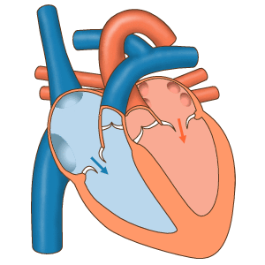
Structure and function of The CIRCULATORY system
Blood flow through the valves:
Valves are located between the atrium and ventricles which ensure blood flows in only one direction – from the atrium to the ventricles.
https://en.wikipedia.org/wiki/Cardiac_physiology#/media/File:Latidos.gif
60
Home

Slide 61
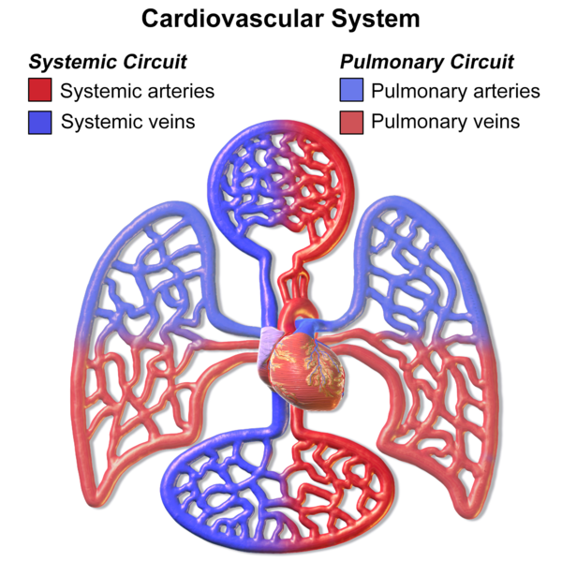
Structure and function of The CIRCULATORY system
CARDIAC CYCLE
Comprises two separate “circuits” in the body in which blood will travel
Left and right side of the heart function as 2 separate pumps
Carries blood from the heart to all parts of the body (except lungs) and back again
Left side of the heart pumps oxygenated blood to the rest of the body via the aorta
Deoxygenated blood returns from the body to the right side of the heart via the vena cava
Systemic Circulation
https://commons.wikimedia.org/wiki/File:Blausen_0168_CardiovascularSystem.png
8
Home

Slide 62

Structure and function of The CIRCULATORY system
Carries blood from the heart to the lungs and back again
Right side of the heart pumps deoxygenated blood to the lungs via the pulmonary artery
Oxygenated blood returns to the heart from the lungs via the pulmonary vein
Pulmonary Circulation
http://commons.wikimedia.org/wiki/File:Illu_systemic_circuit.svg
Home
8

Slide 63

Structure and function of The CIRCULATORY system
https://en.wikipedia.org/wiki/Circulatory_system
©PE STUDIES RESOURCES
63
Home

Slide 64

Structure and function of The CIRCULATORY system
Responsible for carrying blood from the heart, taking it to different parts of the body and then returning it to the heart.
ARTERIES:
Carry blood away from the heart
Blood is pushed through the arteries caused by contractions of the heart
Flow or surge of blood through the arteries with each heart beat can be felt near the surface of the skin – this is referred to as the PULSE
VEINS:
Carry blood towards the heart
Valves which allow the return of blood to the heart, but prevent the back flow of blood
CAPILLARIES:
Tiny blood vessel which reach every cell of the body
Allow the passing of oxygen to tissues and removal of carbon dioxide
Connect arteries and veins
2. Blood vessels
64
Home
https://pixabay.com/en/health-science-circulation-41514/

Slide 65



Structure and function of The CIRCULATORY system
 | FUNCTION | STRUCTURE
ARTERIES | Carry blood away from the heart Blood (with the exception of the pulmonary arteries of the heart) is oxygenated | Thick, muscular walls No valves Blood under high BP
VEINS | Carry blood toward the heart Blood (with the exception of the pulmonary veins) is de-oxygenated | Thin, collapsible walls Valves present Blood under low BP
CAPILLARIES | Allow the passing (diffusion) of oxygen to tissues and removal of carbon dioxide | Very thin walls - only 1 cell thick Branch from the arterioles and venules to form a network
65
Home

Slide 66


Structure and function of The CIRCULATORY system
Fluid that is transported through the pumping action of the heart via the blood vessels, to every cell of the body
Adult human body contains between 5-7L of blood
Serves the following functions:
Transport of nutrients and waste products
Regulation of body’s temperature
Protection of the body
3. Blood
https://pixabay.com/en/photos/blood/?image_type=vector
https://commons.wikimedia.org/wiki/File:Red-blood-cell_illust.svg
66
Home

Slide 67


Structure and function of The CIRCULATORY system
Components of the blood
Plasma (water, nutrients and blood proteins)
Approximately 55% of total blood volume
White Blood Cells
Approximately <1% of total blood volume
Red Blood Cells
Approximately 45% of total blood volume
67
Home

Slide 68

Structure and function of The CIRCULATORY system
Plasma (55%)
Clear yellow fluid, of which 90% is water
Plasma carries the blood cells and is continually passed through capillary walls and into tissues
Provides cells with antibodies, proteins, glucose, salts, fats
Red blood cells (45%)
Give blood its RED colour
Responsible for carrying oxygen to the cells and the removal of carbon dioxide away from the cells of muscles and organs
White blood cells (<1%)
Responsible for moving to sites of infection where they destroy bacteria and other disease causing organisms
Platelets – (make up a very small percentage)
Produced in bone marrow and cause the blood to clot when a vessel is damaged, to prevent excess bleeding
Home
68
http://www.medicalgraphics.de/en/free-pictures/organs/blood-components.html

Slide 69
REVISION QUESTIONS
1. The function of the cardiovascular system is to :
A/ fight disease.
B/ clot the blood.
C/ maintain body temperature.
D/ maintain hydration levels.
E/ all of the above.
F/ none of the above.
2. Blood from the left side of the heart is known as:
A/ atrial.
B/ venous.
C/ deoxygenated.
D/ oxygenated.
3. When the heart contracts it pumps blood into the:
A/ arteries.
B/ veins.
C/ capillaries.
D/ arterioles.
Home
69
http://www.medicalgraphics.de/en/free-pictures/organs/blood-components.html

Slide 70
REVISION QUESTIONS
4. After leaving the heart the blood will take the following pathway:
A/ veins - venules - capillaries - arterioles - arteries.
B/ arterioles - arteries - capillaries - veins - venules.
C/ arteries - veins - capillaries - venules - arterioles.
D/ arteries - arterioles - capillaries - venules - veins.
5. In which of the following does blood have the lowest concentration of oxygen ?
A/ coronary artery
B/ inferior vena cava
C/ pulmonary vein
D/ carotid artery
6. The blood cells responsible for blood clotting are the:
A/ plasma.
B/ platelets.
C/ red blood cells.
D/ white blood cells.
Home
70
http://www.medicalgraphics.de/en/free-pictures/organs/blood-components.html

Slide 71

Structure and function of The respiratory system
Structure and function of the respiratory system
lungs, diaphragm, alveoli
mechanics of breathing
https://www.publicdomainpictures.net/en/view-image.php?image=130311&picture=breathing-organs
71
Home

Slide 72

Structure and function of The respiratory system
Functions of the Respiratory System
Deliver oxygen from the atmosphere to the lungs
2. Provide method of gaseous exchange within the lungs
Oxygen enters the blood, carbon dioxide exits
Create speech as air passes over the vocal cords
Facilitate sense of smell
Expel heat and water vapor in the air breathed out
http://commons.wikimedia.org/wiki/File:Respiratory_system.svg
72
Home

Slide 73


Structure and function of The respiratory system
Structure of the Respiratory System
Comprises 3 main sections:
Air passages
Lungs
Diaphragm
https://commons.wikimedia.org/wiki/File:251000_-_Athletics_track_pentathlon_Don_Elgin_exhausted_2_-_3b_-_2000_Sydney_race_photo.jpg
http://commons.wikimedia.org/wiki/File:Respiratory_system_complete_en.svg
73
Home

Slide 74
Structure and function of The respiratory system
Nasal cavity & mouth
Where the air enters the respiratory system
Pharynx
Where the back of the mouth and nose meet
Larynx
Produces sound when air passes over the larynx
Trachea
Assists with air delivery. Also known as wind pipe.
Bronchi
2 tubes that provide air to the lungs
Bronchioles
Each bronchus subdivides into smaller branches called bronchioles
Alveoli
Cup shaped sacs found at the end of bronchioles
Surrounded by capillaries, they provide the site for continual exchange of 0₂ and CO₂
This occurs by the process of diffusion – the movement of gas from an area of high concentration to low concentration
1. Air passages
http://commons.wikimedia.org/wiki/File:Respiratory_system.svg
74
Home

Slide 75


Structure and function of The respiratory system
Located within the thoracic cavity and protected by the sternum, ribs and vertebral column
They contain the bronchi, bronchioles and alveoli
Gas exchange occurs at the site of the alveoli
2. The Lungs
https://en.wikipedia.org/wiki/Lung
https://commons.wikimedia.org/wiki/File:Lungs.gif
75
Home

Slide 76

Structure and function of The respiratory system
The exchange of and occurs at two sites in the body via diffusion:
Lungs (Alveoli/Capillary interface)
Muscles (Capillary/Muscle interface)
DIFFUSION – the movement of substances from a high to low concentration through a semi-permeable membrane
Oxygen
(O₂)
Carbon Dioxide
(CO₂)
https://commons.wikimedia.org/wiki/File:Diffusionofonesolute.jpg
76
Home

Slide 77


Structure and function of The respiratory system
When we inhale, O₂ moves through the lungs and into the alveoli where it diffuses into the blood to be transported to the tissues
Gas exchange takes place due to a concentration difference called a concentration gradient
The alveoli has a high concentration of O₂
The venous blood capillary has a low concentration of O₂
This concentration differential between the alveoli and venous capillaries causes O₂ to move from the alveoli into the blood capillary (from an area of high to low concentration).
http://www.medicalgraphics.de/en/free-pictures/organs/alveoli.html
©PE STUDIES RESOURCES
https://en.wikipedia.org/wiki/Gas_exchange
77
Home

Slide 78

Structure and function of The respiratory system
Gas exchange at the alveoli/capillary interface
https://ku.m.wikipedia.org/wiki/W%C3%AAne:Alveoli.svg
moves from the alveoli of the lungs into the capillaries which surround them. moves from the capillaries into the alveoli to be expired.
Oxygen
Carbon Dioxide
moves because of a high concentration in the alveoli to the capillaries where they are of low concentration.
Oxygen
moves because of a high concentration in the capillaries to a low concentration in the alveoli.
Alveoli features that allow efficient gas exchange to occur:
Large surface area to volume ratio - so lots of opportunity for gas exchange to occur
Surrounded by capillaries – to allow for gas exchange to occur efficiently into the blood
Very thin walls – to promote diffusion of gases
Carbon Dioxide
This concentration gradient is maintained by continuous inspiration of oxygen and expiration of the carbon dioxide as well as continuous flow of blood to and from the blood capillaries.
https://www.youtube.com/watch?v=mZvzl8KH6iI&ab_channel=ScienceSauce
https://www.youtube.com/watch?v=57byXpOUpSU&ab_channel=TeachPE
78
Home

Slide 79



Structure and function of The respiratory system
Gas exchange at the capillary/muscle interface
Diffusion of gases also occurs at the muscle to allow the transport of to muscle tissue and (a by-product) to be removed.
Oxygen
Carbon Dioxide
is of a high concentration in the capillaries so moves to the muscle tissue where it is of low concentration.
Oxygen
Muscle
is of high concentration in the muscle tissue so moves to the capillaries where it is of a low concentration.
Carbon Dioxide
https://commons.wikimedia.org/wiki/File:Illu_capillary.jpg
79
Home

Slide 80

Structure and function of The respiratory system
Involuntary or smooth muscle that contracts and relaxes to aid breathing at all times
As the diaphragm moves up and down, the size of the chest cavity changes, causing breathing
3. The Diaphragm
http://commons.wikimedia.org/wiki/File:Diaphragmatic_breathing.gif
https://pixabay.com/en/human-respiratory-lungs-anatomy-312757/
80
Home

Slide 81

mechanics of breathing
The mechanics of breathing
Consists of 2 movements (inspiration & expiration) operating on the principal that gases move from an area of high pressure to low pressure:
INSPIRATION (breathing in)
Volume of lungs increases
External intercostal muscles contract & internal intercostal muscles relax to lift rib cage up and the diaphragm contracts to become flatter (this causes a larger volume and thus an area of low pressure)
Air enters the lungs moving from area of high pressure to low pressure
Inspiration
http://commons.wikimedia.org/wiki/File:Inhalation_diagram.svg
81
Home

Slide 82

mechanics of breathing
The mechanics of breathing
EXPIRATION (breathing out)
Volume of lungs decreases
External intercostal muscles relax and internal intercostal muscles contract to lower rib cage and diaphragm relaxes to become dome shaped (this causes a smaller volume and thus an area of high pressure)
Air exits the lungs from an area of high pressure to low.
Expiration
Inspiration
http://commons.wikimedia.org/wiki/File:Inhalation_diagram.svg
http://commons.wikimedia.org/wiki/File:Expiration_diagram.svg
82
Home

Slide 83
mechanics of breathing
INSPIRATION
Intercostals | Contract
Diaphragm | Contracts
Lung volume | Increases
Air pressure in lungs | Decreases
EXPIRATION
Intercostals | Relax
Diaphragm | Relaxes
Lung volume | Decreases
Air pressure in lungs | Increases
http://commons.wikimedia.org/wiki/File:Diaphragmatic_breathing.gif
83
Home

Slide 84
Revision Questions
1. The function of the respiratory system is to :
A/ pump blood around the body.
B/ regulate hydration levels.
C/ extract oxygen from the air.
D/ all of the above.
2. The pathway from the environment to the lungs is as follows:
A/ pharynx - larynx - trachea - bronchi - bronchioles - alveoli.
B/ trachea - pharynx - bronchi - larynx - bronchioles - alveoli.
C/ alveoli - bronchioles - bronchi - trachea - pharynx - larynx.
D/ larynx - pharynx - trachea - bronchi - bronchioles - alveoli.
3. The major muscles used in respiration are the:
A/ diaphragm and abdominals.
B/ diaphragm and intercostals.
C/ Abdominals and intercostals.
D/ trapezius and peroneus longus.
4. The major muscles used in respiration are the:
A/ diaphragm and abdominals.
B/ diaphragm and intercostals.
C/ Abdominals and intercostals.
D/ trapezius and peroneus longus.
84
Home

Slide 85
Revision Questions
5. The exchange of gas in the lungs takes place between which two structures ?
A/ capillaries and muscle cells
B/ capillaries and alveoli
C/ arteries and veins
D/ veins and alveoli
6. During expiration the diaphragm:
A/ contracts and flattens.
B/ relaxes and flattens.
C/ contracts and becomes dome shape.
D/ relaxes and becomes dome shape.
85
Home

Slide 86
REFERENCES
Dawson, T., Dawson, P. (2007). E – Teaching Physical Education compact disc 1.
McArdle, W., Katch, F., Katch, V. (2001). Exercise Physiology (5th ed.). Energy, Nutrition and Human Performance. Baltimore, Maryland: Lippincott Williams & Wilkins.
McPartland, D., Pree, A., Malpeli, R., Telford, A. (2010). Physical Education Studies for 3A,3B. South Melbourne, VIC: Cengage Learning Australia Pty Limited.
O’Keeffe, Walsh, Cleary, Millar, Quinlan (2017). Live It Up 1 VCE Physical Education Units 1 & 2. 4th Edition. Jacaranda
School Curriculum and Standards Authority. Physical Education Studies ATAR Year 11 Syllabus, 2016.
Smyth, D., Brown, H., Judge, W., McCallum, C., Pritchard, R. (2006). Live it up 2 (2nd ed.). Milton, QLD: John Wiley & Sons Australia, Ltd.
Smyth, D., Brown, H., Judge, W., McCallum, C., Wright, P. (2006). Live it up 1 (2nd ed.). Milton, QLD: John Wiley & Sons Australia, Ltd.
Telford, Malpeli, Whittle, Seery, Corrie (2016). Nelson Physical Education VCE Units 1 and 2. 2nd Edition. Cengage Learning Australia Pty Ltd.
Whipp, P., Elliot, B., Guelfi, K., Dimmock, J., Lay, B., Landers, G., Alderson, J. (2010). 3A-3B Physical Education Studies: A Textbook for Teachers and Students. Crawley, WA: UWA Publishing.
Whipp, P., Elliot, B., Guelfi, K., Dimmock, J., Lay, B., Landers, G., Alderson, J., Haendel, B., Peeling, P., Leslie, M. (2016). ATAR Units 1 and 2 Physical Education Studies: A Textbook for Students. Crawley, WA: UWA Publishing.
Wilmore, J., Costill, D. (1994). Physiology of Sport and Exercise. Champaign, IL: Human Kinetics.
86
Home

